Slide 1
CHAPTER 2
Asset Classes and Financial Instruments

Slide 2
Asset Classes
Money market instruments
Capital market instruments
  Bonds
  Equity Securities
  Derivative Securities

Slide 3
The Money Market
Subsector of the fixed-income market: Securities are short-term, liquid, low risk, and often have large denominations
Money market mutual funds allow individuals to access the money market.

Slide 4
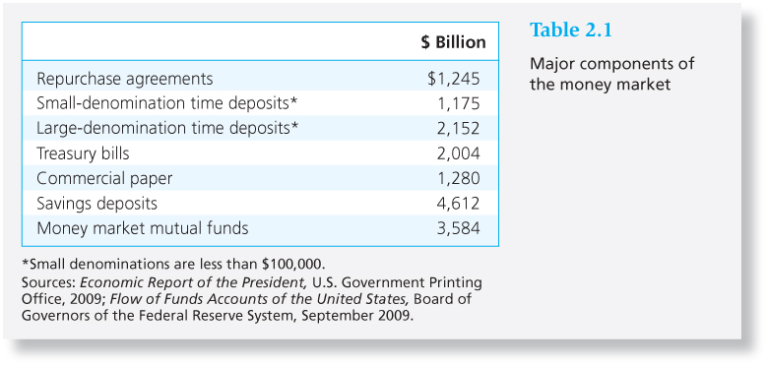
Table 2.1 Major Components of the Money Market

Slide 5
Money Market Securities
Treasury bills: Short-term debt of U.S. government
  Bid and asked price
  Bank discount method
Certificates of Deposit: Time deposit with a bank
Commercial Paper: Short-term, unsecured debt of a company

Slide 6
Money Market Securities
Bankers’ Acceptances: An order to a bank by a bank’s customer to pay a sum of money on a future date
Eurodollars: dollar-denominated time deposits in banks outside the U.S.
Repos and Reverses: Short-term loan backed by government securities.
Fed Funds: Very short-term loans between banks

Slide 7
Yields on Money Market Instruments
Except for Treasury bills, money market securities are not free of default risk
Both the premium on bank CDs and the TED spread have often become greater during periods of financial crisis
During the credit crisis of 2008, the federal government offered insurance to money market mutual funds after some funds experienced losses

Slide 8
The Bond Market
Treasury Notes and Bonds
Inflation-Protected Treasury Bonds
Federal Agency Debt
International Bonds

Slide 9
The Bond Market
Municipal Bonds
Corporate Bonds
Mortgages and Mortgage-Backed Securities

Slide 10
Treasury Notes and Bonds
Maturities
  Notes – maturities up to 10 years
  Bonds – maturities from 10 to 30 years
Par Value - $1,000
Interest paid semiannually
Quotes – percentage of par

Slide 11
The Bond Market
Inflation-Protected Treasury Bonds
  TIPS: Provide inflation protection
Federal Agency Debt
  Debt of mortgage-related agencies such as Fannie Mae and Freddie Mac
International Bonds
  Eurobonds and Yankee bonds

Slide 12
Municipal Bonds
Issued by state and local governments
Interest is exempt from federal income tax and sometimes from state and local tax

Slide 13
Municipal Bonds
Types
  General obligation bonds: Backed by taxing power of issuer
  Revenue bonds: backed by project’s revenues or by the municipal agency operating the project.

Slide 14
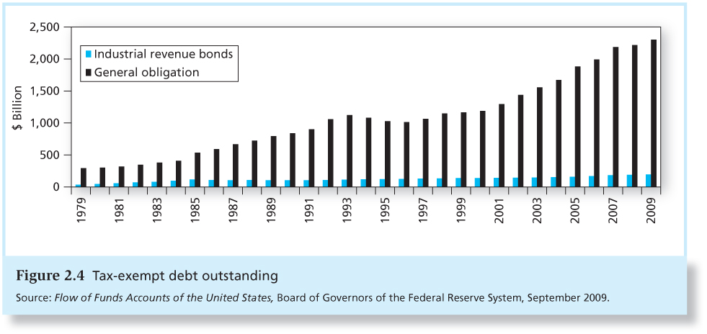
Figure 2.4 Tax-exempt Debt Outstanding

Slide 15
Municipal Bond Yields
To choose between taxable and tax-exempt bonds, compare after-tax returns on each bond.
Let t equal the investor’s marginal tax bracket
Let r equal the before-tax return on the taxable bond and r _{m} denote the municipal bond rate.
If r (1 - t ) > r _{m} then the taxable bond gives a higher return; otherwise, the municipal bond is preferred.

Slide 16
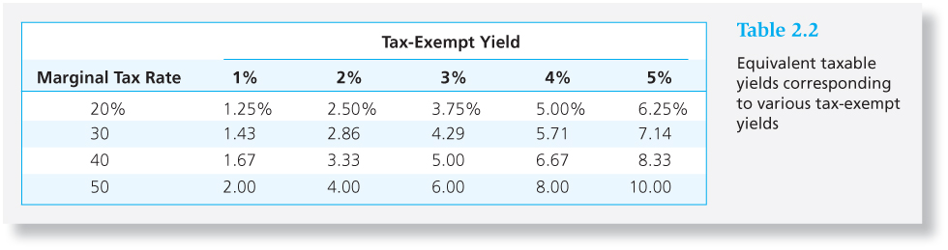
Table 2.2 Tax-Exempt Yield Table
The equivalent taxable yield is simply the tax-free rate, r_{m} , divided by (1-t).

Slide 17
Corporate Bonds
Issued by private firms
Semi-annual interest payments
Subject to larger default risk than government securities
Options in corporate bonds
  Callable
  Convertible

Slide 18
Mortgage-Backed Securities
Proportional ownership of a mortgage pool or a specified obligation secured by a pool
Produced by securitizing mortgages
  Mortgage-backed securities are called pass-throughs because the cash flows produced by homeowners paying off their mortgages are passed through to investors.

Slide 19
Mortgage-Backed Securities
Most mortgage-backed securities were issued by Fannie Mae and Freddie Mac.
Traditionally, pass-throughs were comprised of conforming mortgages, which met standards of credit worthiness.

Slide 20
Mortgage-Backed Securities
Eventually, “Private-label” issuers securitized large amounts of subprime mortgages, made to financially weak borrowers.
Finally, Fannie and Freddie were allowed and even encouraged to buy subprime mortgage pools.
September, 2008: Fannie and Freddie got taken over by the federal government.

Slide 21
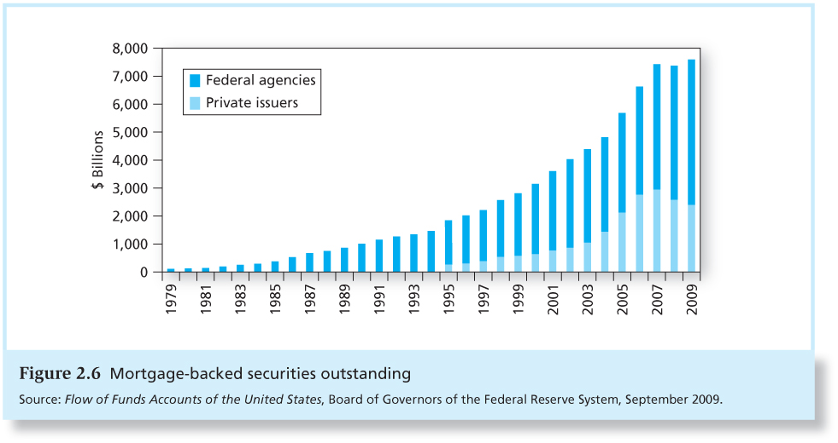
Figure 2.6 Mortgage-backed securities outstanding

Slide 22
Equity Securities
Common stock: Ownership
  Residual claim
  Limited liability
Preferred stock: Perpetuity
  Fixed dividends
  Priority over common
  Tax treatment
American Depository Receipts

Slide 23
Stock Market Indexes
Dow Jones Industrial Average
  Includes 30 large blue-chip corporations
  Computed since 1896
  Price-weighted average

Slide 24
Example 2.2 Price-Weighted Average
Portfolio: Initial value $25 + $100 = $125
Final value $30 + $ 90 = $120
Percentage change in portfolio value
= 5/125 = -.04 = -4%
Index: Initial index value (25+100)/2 = 62.5
Final index value (30 + 90)/2 = 60
Percentage change in index -2.5/62.5
= -.04 = -4%

Slide 25
Standard & Poor’s Indexes
S&P 500
  Broadly based index of 500 firms
  Market-value-weighted index
Investors can base their portfolios on an index:
  Buy an index mutual fund
  Buy exchange traded funds (ETFs)

Slide 26
Other Indexes
U.S. Indexes
Foreign Indexes
NYSE Composite
NASDAQ Composite
Wilshire 5000
Nikkei (Japan)
FTSE (U.K.; pronounced “footsie”)
DAX (Germany),
Hang Seng (Hong Kong)
TSX (Canada)

Slide 27
Derivatives Markets
Options and futures provide payoffs that depend on the values of other assets such as commodity prices, bond and stock prices, or market index values.
A derivative is a security that gets its value from the values of another asset.

Slide 28
Options
Call: Right to buy underlying asset at the strike or exercise price.
  Value of calls decrease as strike price increases
Put: Right to sell underlying asset at the strike or exercise price.
  Value of puts increase with strike price
Value of both calls and puts increase with time until expiration.

Slide 29
Futures Contracts
A futures contract calls for delivery of an asset (or in some cases, its cash value) at a specified delivery or maturity date for an agreed-upon price, called the futures price, to be paid at contract maturity.
Long position: Take delivery at maturity
Short position: Make delivery at maturity

Slide 30
Comparison
Option
Futures Contract
Right, but not obligation, to buy or sell; option is exercised only when it is profitable
Options must be purchased
The premium is the price of the option itself.
Obliged to make or take delivery. Long position must buy at the futures price, short position must sell at futures price
Futures contracts are entered into without cost

